Slide 1

Protocol Design Considerations
Version 1, Presented at QuTech (Delft) on 22 November 2019

Slide 2
Multi-version, multi-vendor, multi-feature. The Internet is an uncontrolled mixture of devices from different vendors running different versions of code which support different combinations of features.

Slide 3

Interop between protocol versions
Version X needs to interoperate with version Y.
For any X and Y, not just Y = X + 1.
Don’t assume contiguous “regions” of same version.
Different devices will run different version of your protocol.
Temporarily during upgrade. You cannot upgrade your devices all at once; it takes a lot of time.
Or semi-permanently due to operational considerations (e.g. different vendors support different versions of the protocol). You want to be able to have multiple vendors in the same network.
Version 1
Version 2
Version 1
Version 1
Version 3

Slide 4
Lessons learned from major version bumps
IPv4 vs IPv6
IPv6 is not backwards compatible with IPv4
Upgrading from IPv4 to IPv6 is a royal pain in the neck
It’s been 20 years and IPv6 is still not universally deployed
IPv4 will never go away
OSPFv3 vs OSPFv2
OSPFv3 is not backwards compatible with OSPFv2
You need to upgrade from OSPFv2 to OSPFv3 to get IPv6
Real networks run OSPFv2 and OSPFv3
ISIS did it right (ISIS with IPv6 can interoperate with ISIS without IPv6)
BGPv3 vs BGPv4 vs …BGPv5?
BGPv3 is not backwards compatible with BGPv4, it required every Internet core router to be upgraded
Upgrading every core router on the Internet is infeasible at this time
BGPv4 has excellent extension mechanisms; it is unlikely that there will ever be a BGPv5

Slide 5
Interop between feature sets
Protocol implementation that has feature A must interoperate with protocol implementation that does not have feature A.
Different vendors and versions of code have different feature sets.
Don’t assume the feature set can be derived from the protocol version. Allows protocol extensions to evolve and be deployed independently.
Don’t assume the feature set is the same. Feature set A+B must interoperate with B+C.
A
D
B
C
C
D
A
B
D
A
B
C
Protocol features
A
B
C
D

Slide 6
Capability announcement (“negotiation”)
A
B
C
B
C
D
I support features A, C, D
I support features B, C, D
We can use features B, C (these are the ones we have in common)
We can use features B, C (these are the ones we have in common)
(Things get a bit more complicated when more than 2 devices are involved, e.g. flooding)

Slide 7
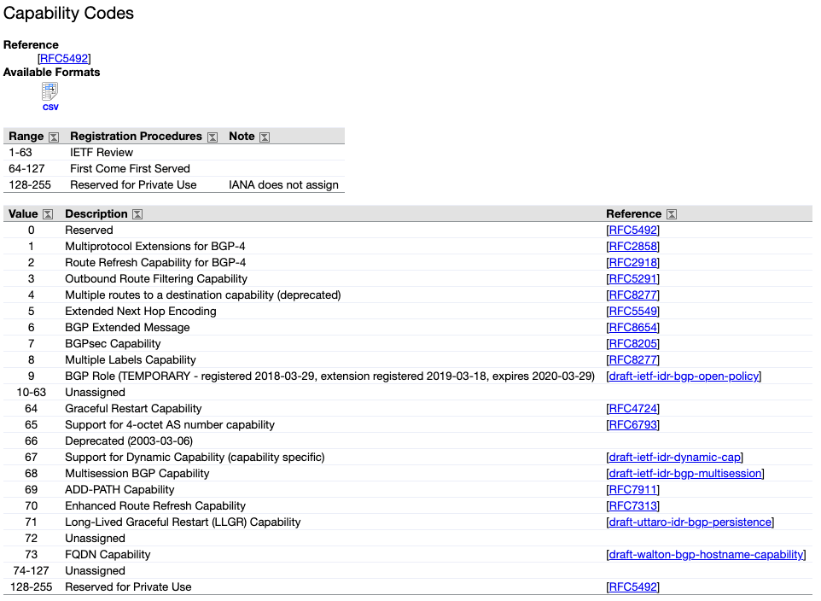
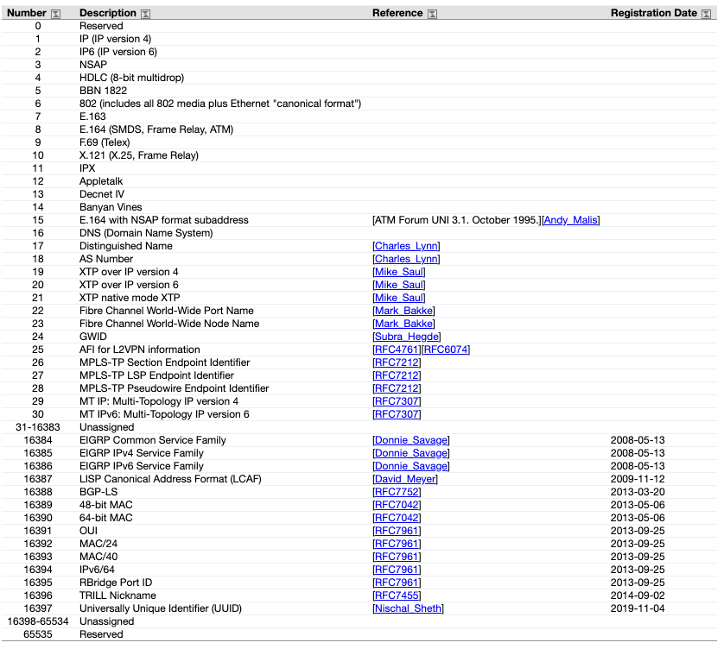
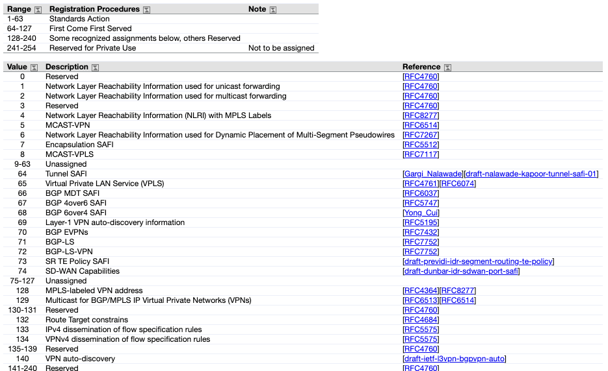
Example: BGPv4 capabilities

Slide 8
Type Length Value (TLV) Encoding

Slide 9
Transitive bits

Slide 10
Crashes and planned upgrades. There is no such thing as a maintenance window on the Internet.

Slide 11
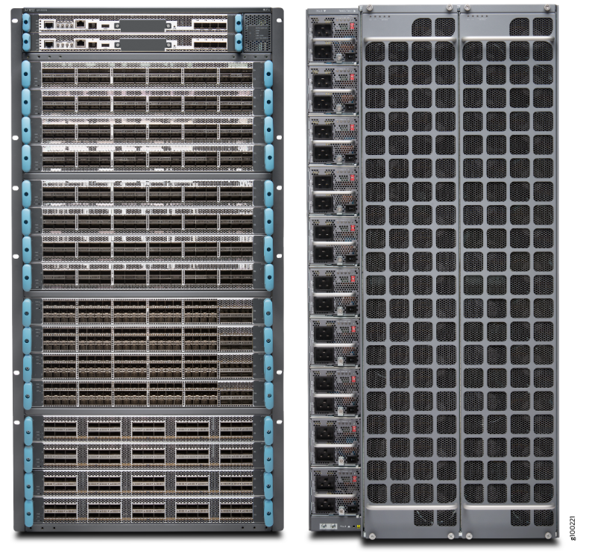
Chassis devices
Redundant control planes (routing engines)
Everything (routing engine, switch fabric, power supplies, fans, …) redundant and in-service replaceable

Slide 12
In-Service Software Upgrade (ISSU)
Active routing engine
Version 1
Active routing engine
Version 1
Active routing engine
Version 1
Active routing engine
Version 2
Standby routing engine:
Version 1
Standby routing engine:
Version 2
Standby routing engine:
Version 2
Standby routing engine:
Version 2
Forwarding engine
Forwarding engine
Forwarding engine
Forwarding engine
Forwarding engine
Forwarding engine
Forwarding engine
Forwarding engine
Upgrade
standby
Switch-over
Upgrade
new standby

Slide 13
Non-Stop Forwarding (NSF) Also known as Graceful Restart (GR)
Control-plane session
PREPARE FOR RESTART
Control-plane session PREPARE FOR RESTART
Active routing engine: version 1
Standby routing engine: version 2
Data-plane traffic
Forwarding engine
Data-plane traffic
Active routing engine: version 1
Control-plane session
RESYNCHRONIZE
Standby routing engine: version 2
Control-plane session RESYNCHRONIZE
Data-plane traffic
Forwarding engine STALE TABLES
Data-plane traffic
Active routing engine: version 1
Control-plane session
RESTART FINISHED
Standby routing engine: version 2
Control-plane session RESTART FINISHED
Data-plane traffic
Data-plane traffic
Forwarding engine

Slide 14
Pizza-box devices
Does not have redundant routing hardware routing engines.
(Sometimes in redundant software routing engines using virtual machines or containers.)

Slide 15
Non-Stop Routing (NSR)

Slide 16
Scale-out instead of scale-up

Slide 17
Relatively small impact of losing one device
For planned upgrades, announce in advance (e.g. overload flag) to shift traffic away, if possible.

Slide 18
Soft state does not scale. Periodic protocols do not scale. Use hard state instead.

Slide 19
Use existing reliability mechanisms. Don’t invent your own reliability mechanism. Run over a transport when possible.

Slide 20
You need flow and congestion control. Not just in application protocols, but also in routing and signaling protocols.

Slide 21
Protocol correctness is hard. Much harder than you think.

Slide 22
1980: The entire Internet had to be rebooted

Slide 23
Implementation correctness is hard. Much harder than you think.

Slide 24
Don’t hand-code your parsers
Type Length Value (TLV) encoding (we saw this before!)
Formal modeling language for on-the-wire protocol
Abstract Syntax Number 1 (ASN.1)
YANG
Google Protocol Buffers (BGP), Thrift, etc.
@@@ Example of real-life bug

Slide 25
Thank you.

Slide 26
References
Some lessons from history (“Those who do not know history are doomed to repeat it”) https://datatracker.ietf.org/meeting/102/materials/slides-102-rtgarea-those-who-do-not-learn-history-are-doomed-to-repeat-it-00

